Slide 1
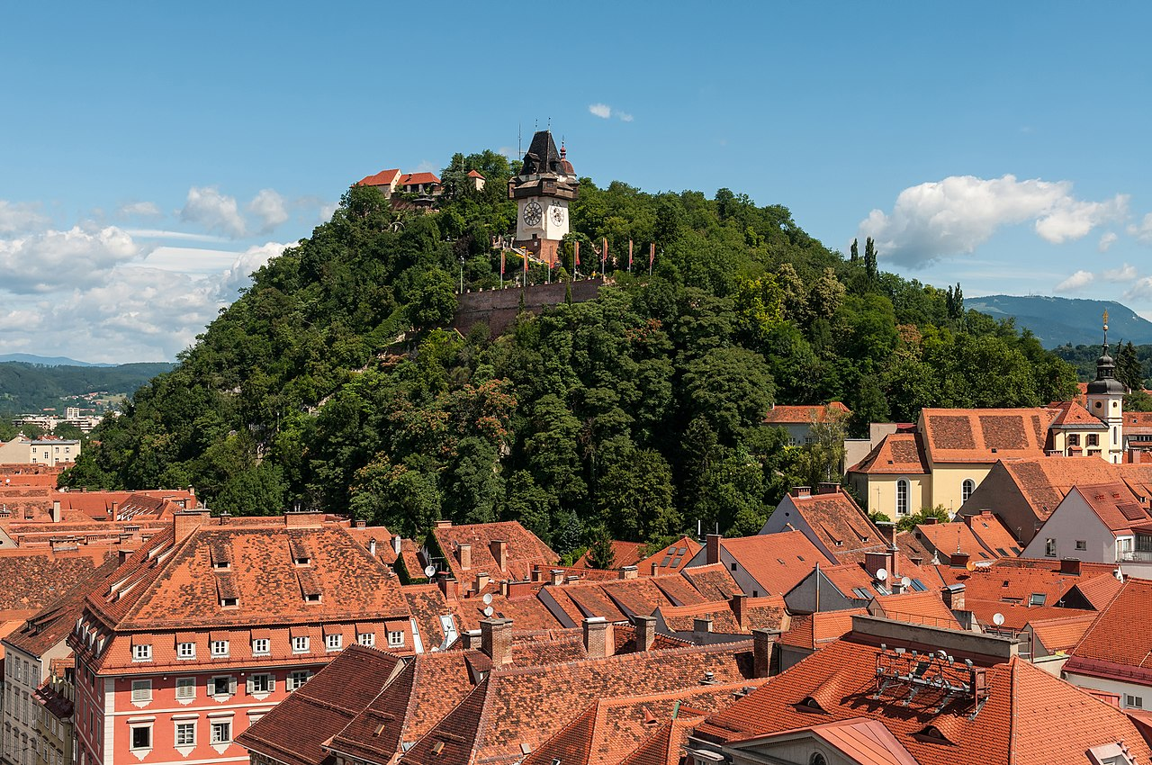
The Tourist
Graz as seen by Grazers as experienced by a platformer hero

Slide 2
Surviving Graz
It is something we do every day
We demonstrate the challenges that this entails
You are a tourist
Find your way to the city’s many destinations!
Battle annoying hipsters, evil BWL students, and more!
Choose your outfit to take the perfect selfie!

Slide 3

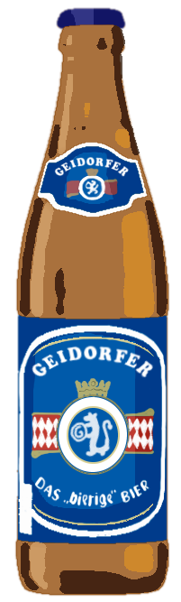
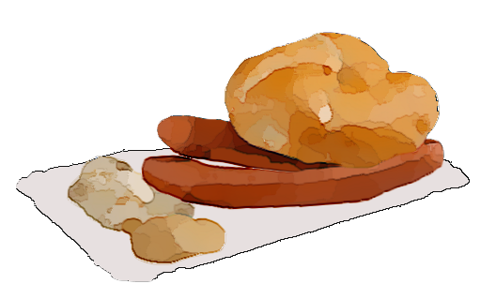
Your Goal
Jump and run through unique levels
Interact with objects in your environment
Use trashcans and theater seats to overcome obstacles
Eat “Döner”, drink “Geidorfer” ^{(not trademarked)} beer, and have “Frankfurter mit Semmel” to power up your hero
Collect selfies at all of the tourist destinations

Slide 4
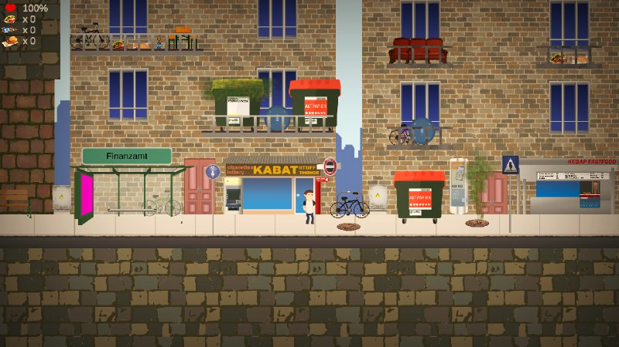
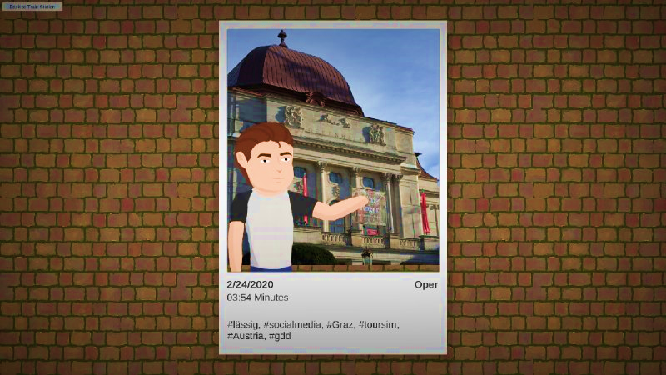
Gameplay Overview
Keep track of your health and your collected upgrades at a glance.
Move throughout the levels Interact with the objects in the world to navigate to the end Your reward: a personalized selfie in front of your goal!

Slide 5
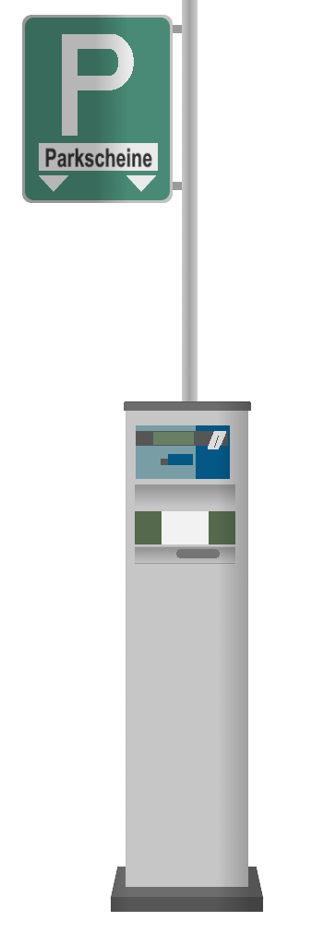
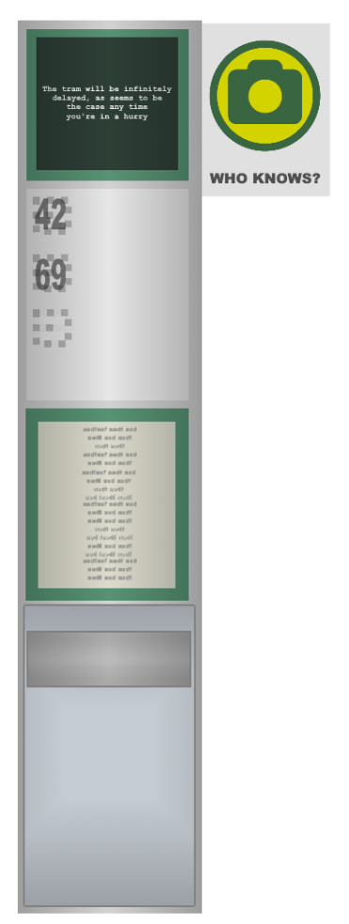




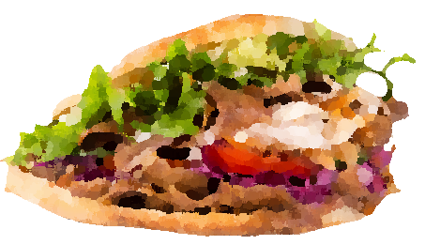

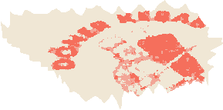
Game Overview
The current version of the game has 6 fully playable levels Take selfies at the:
Historic opera
Modern art museum
Iconic clock tower
…and more
Enjoy dozens of hand-crafted sprites that highlight the Graz we take for granted

Slide 6
Gameplay Demo

Slide 7
Thank you for your attention
Image credit: Wikimedia Austria
Music: https://www.bensound.com

